Slide 1
Monthly PowerBI Workshops
AF M&E CoP

Slide 2
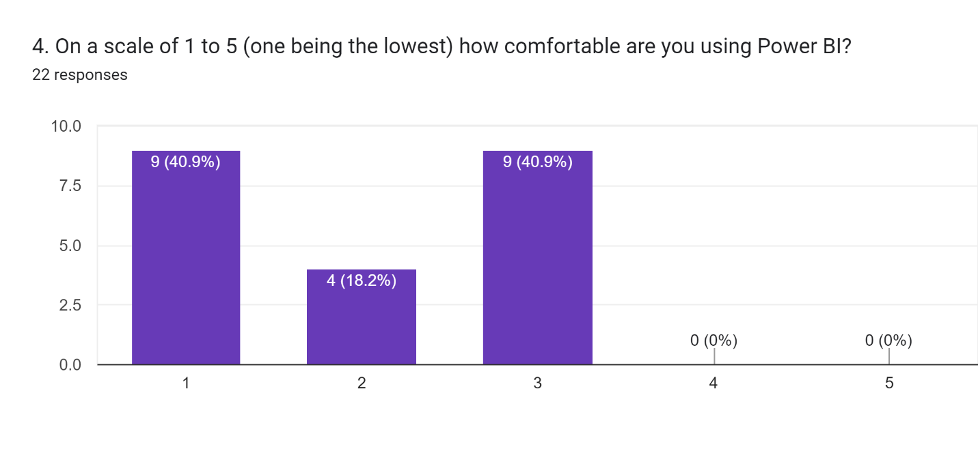
On a scale of 1 to 5 (1 being the lowest) how comfortable are you using Power BI?
The results show that 40.9% of responders think their skills are average while the other 40.9% say they are not at all comfortable with it. The remaining 18.2% ranked themselves right below average.
Notes:
No experts or above average. Majority are below average or indicated no comfort

Slide 3
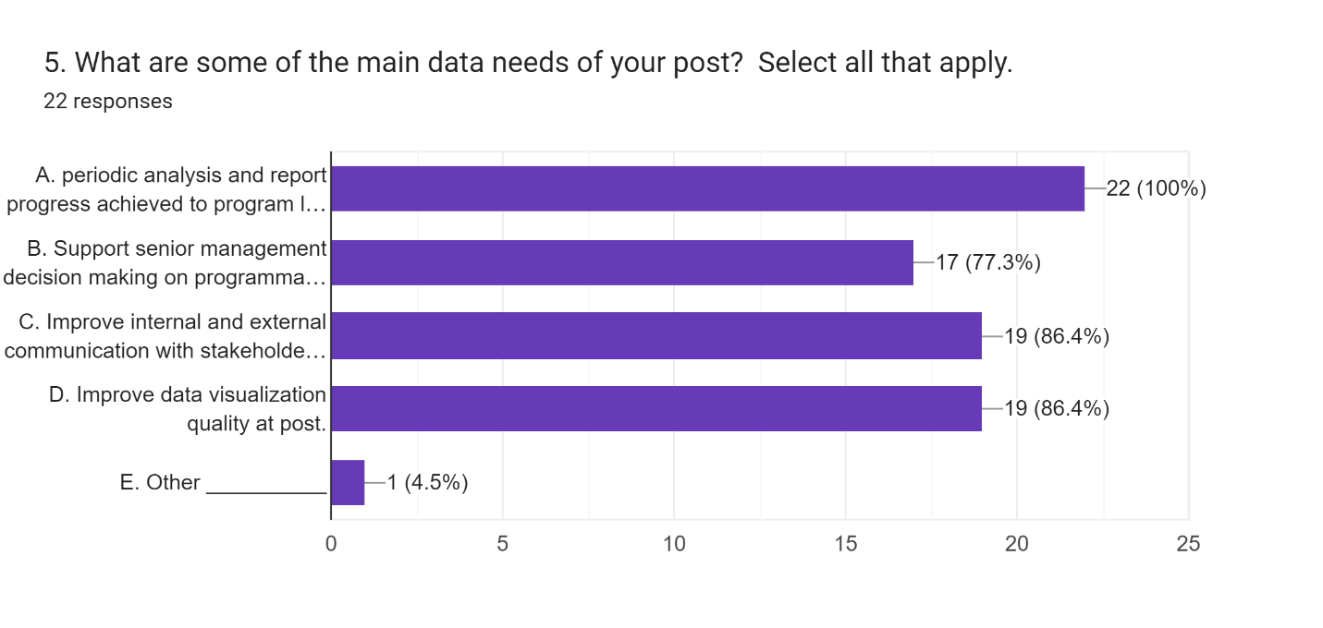
What are some of the main data needs of your post?
The results show that everyone uses data for periodic analysis and report progress achieved to program leaders via dashboards, charts, etc. 86% use it to improve internal and external communication with stakeholders/partners and to improve data visualization quality at post.
77% use data to support senior management decision making on programmatic and management issues. Under “Other” uses included sharing data with PCVs to share with their local supervisors, counterparts, and stakeholders.
Notes:
Highlight these data needs and explain that a goal of the training/workshops will be to address these needs.

Slide 4
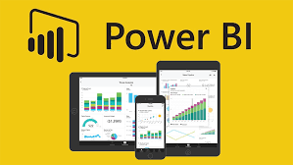
Workshop Objectives
Learn what PowerBI is
Become familiar with PowerBI training resources
Understand how to utilize PowerBI for Peace Corps work
Develop agency SOPs and best practices for PowerBI
Build data literacy skills using PowerBI
Build PowerBI knowledge hub in AF region

Slide 5
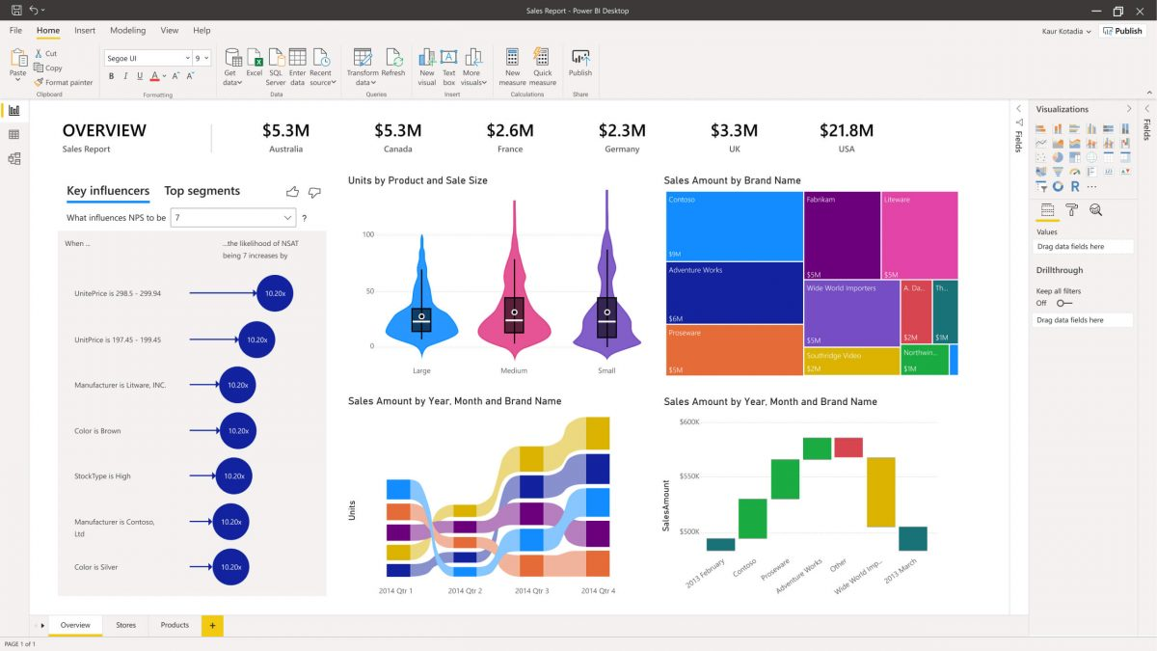
PowerBI Skills to be covered
Terminology
PowerBI products
Power Query data management
Import data
Creating visuals
Formatting visuals
Custom indicators/columns
Slicers
Exporting data/report
Publishing/Sharing

Slide 6
Workshop Structure
Convene once a month
Homework:
Facilitators will instruct what to watch for upcoming workshop
Watch prescribed LinkedIn learning videos on PowerBI before workshop
Possible exercises/practice
At Workshop:
Live demos/walkthroughs of concepts
Discussion/Q&A

Slide 7
LinkedIn Learning
Getting Started with PowerBI
https://www.linkedin.com/learning/getting-started-with-power-bi-18783686/analyze-and-visualize-your-business-data?resume=false&u=2187828

Slide 8
First Workshop – July 20th
LinkedIn Learning: Watch videos here - Getting Started with PowerBI
https://www.linkedin.com/learning/getting-started-with-power-bi-18783686/analyze-and-visualize-your-business-data?resume=false&u=2187828
We will discuss these Videos:
Get Started with PowerBI (3 vidoes + quiz)
Getting Started with PowerBI (3 videos + quiz)

